Slide 1
軽量トランスフォーマー・アンサンブルモーダル (Lightweight Transformer Ensemble Model ) を用いた自動運転車における 歩行者行動予測
電子機械類 知能制御プログラム
指導教員：Kamal Md Abdus Samad
T220G902 Nguyen Bao Viet

Slide 2
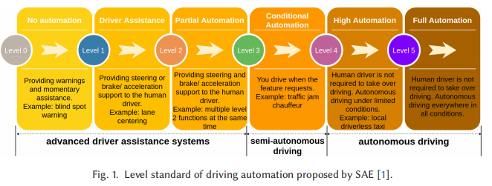
背景
自動運転はレベル1（運転支援）からレベル5（完全自動化）まで分類される。
レベル3以上では、常に人間の監視なしに車が交通状況が判断できる力が必要である。

Slide 3
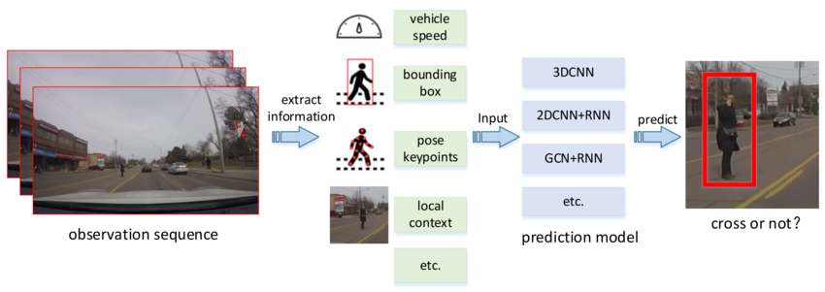
背景
そこで、大切な技術の一つは「歩行者行動予測」である。
これは、歩行者の動きや姿勢、周囲をもとに、横断、停止、方向転換などを予測する技術である。
Zhou, Xiao & Ren, Hongyu & Zhang, Tingting & Mou, Xingang & He, Yi & Chan, Ching-Yao. (2022). Prediction of Pedestrian Crossing Behavior Based on Surveillance Video. Sensors. 22. 1467. 10.3390/s22041467.

Slide 4
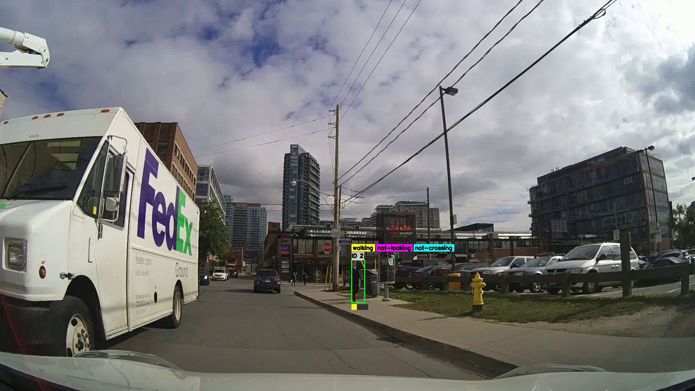

Slide 5
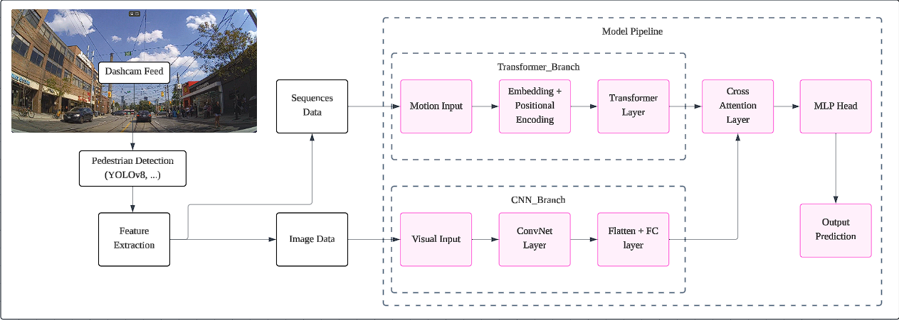
提案のモデル

Slide 6

This sucks, actually.
これ、まずい。

Slide 7
Why did it suck
1. Overpowered model for oversimplified input
過度に単純化された入力に対する強力なモデル
The Transformer branch received only low-level motion vectors: (x,y,dx,dy) sequences, which lacks the spatial–temporal richness Transformers are designed to model (no texture, shape, or high-dimensional structure).
As a result, the Transformer overfit easily, memorizing simple motion patterns instead of learning meaningful behavior cues.
=> I used a cannon to shoot a sparrow - 大砲で雀を撃つ

Slide 8
Why did it suck
2. CNN backbone dominated the model
The CNN feature extractor (MobileNetV2 / EfficientNet-B0) held the majority of parameters and extracted strong semantic features almost independently.
The Transformer became more of a passive add-on.
In short：
I gave a complex Transformer too little to learn from, and handed too much responsibility to a frozen pretrained CNN.
複雑な Transformer に学習させる要素が少なすぎて、固定された事前トレーニング済みの CNN に任せきりになってしまいました。

Slide 9
Solution
Simpler backbone for low-level temporal data - Temporal Convolutional Network, LSTM, GRU, etc.
Utilize Transformer for high-level, feature-rich visual data -> Vision Transformer

Slide 10
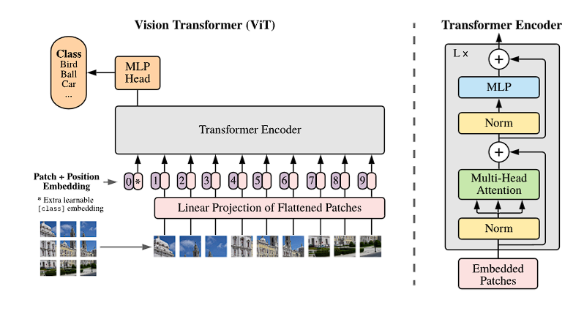
Vision Transformer
A Dosovitskiy et al, “An Image is Worth 16x16 Words: Transformer for Image Recognition at Scale”, 2021.

Slide 11
Vision Transformer
Paper / Model | Key Insights / Innovations | How It Informs Our Design
A Dosovitskiy et al, “An Image is Worth 16x16 Words: Transformer for Image Recognition at Scale”, 2021. | Treat images as patch sequences; flatten → linear embedding Use pure Transformer encoders, no convolution inductive bias | We adopted the patch embedding + transformer architecture as baseline.
Z Liu et al, “Swin Transformer: Hierarchical Vision Transformer using Shifted Window”, 2021. | Hierarchical design with patch merging between stages Local windowed self-attention + shifting windows | We borrow hierarchical staging and local window attention ideas.
C Ryali et al, “Hiera: a hierarchical vision transformer without the bells-and-whistles”, 2023 | Simplify hierarchical transformer: remove extra modules & biases Use MAE pretraining to let model learn spatial biases instead of hard-coding them | We follow the philosophy of simplicity, avoiding overly complex modules
Our Model | We combine hierarchical ViT with temporal branch, keeping design as minimal and interpretable as possible.

Slide 12
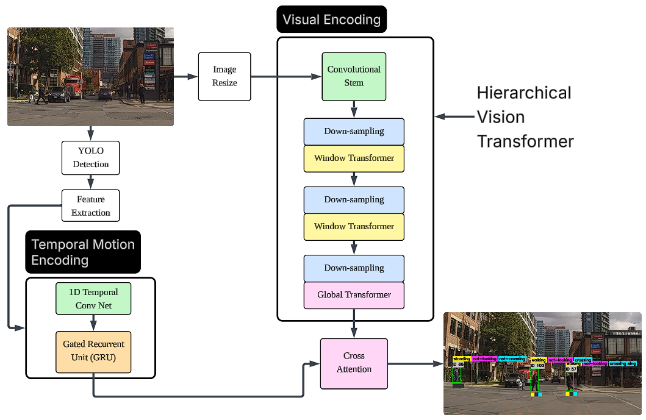
提案のモデル

Slide 13
Improvement
Temporal ConvNet + GRU handle motion data - simple, minimal computational weight, suitable for low-level data
Hierarchical Vision Transformer :
Hierarchical = multi-scale, captures both fine details and global context by gradually reducing spatial resolution.
Local window attention: efficient computation, reduce computational weight for lightweight model implementation
Cross attention mechanism: retain.

Slide 14
Initial Result
After regularization (adjusting dropout, weight decay, learning rate, scheduler)
Before regularization

Slide 15
Future plan
Fine-tuning model
Preparing testing data. Run multiple experiments for efficiency - accuracy balance testing.
Real time deployment experiments.

